Slide 1
Mast Cell Activation Disease:
Current Concepts
Wellapalooza 2016
June 11, 2016
Lawrence B. Afrin, M.D.
Division of Hematology, Oncology & Transplantation
University of Minnesota

Slide 2
Learning Objectives & Disclaimers
Learning Objectives
  Understand emerging concepts regarding mast cell disease
  Understand recent, current, and planned research at UMN in mast cell disease
Conflicts of Interest
  None

Slide 3
Outline
What is mast cell activation disease (MCAD)?
  What we’ve long known:
    Allergic diseases……………………………………….....
    Mastocytosis………………………………………………..
  What’s new:
    Mast cell activation syndrome (MCAS)…….….
What research are we conducting in MCAD?
General Clinical Theme
Allergy ± Inflammation
Allergy + MC Neoplasia ± Inflammation
Inflammation ± Allergy

Slide 4
Allergic Diseases
Allergy, asthma, angioedema, urticaria, anaphylaxis
2013: 700 million suffer allergic diseases worldwide
  10% of preschoolers worldwide now have food allergies
Steadily increasing incidence/prevalence across all ages
  e.g., China (prevalence): 1999: 3.5%; 2009: 7.7%
  Greatest increases in children < 5 years old
Allergic diseases are conditioned by a number of genes and influenced by environmental factors
  Incidence of allergic disease in children if…
    …neither parent suffers allergic disease: 5-15%
    …only one parent suffers allergic disease: 20-40%
    …both parents suffer allergic disease: ≥ 60%
Relatively little mortality, but significant QoL effects
1. Prescott SL et al. A global survey of changing patterns of food allergy burden in children. World Allergy Organiz J 2013;6:21, pp. 1-12.
2. Pawlinska-Chmara R et al., Effect of Socio-Economic Status on Quality of Life in People Affected with Respiratory Allergy, pp. 385-392, in M. Pokorski (ed.), Neurobiology of Respiration, Advances in Experimental Medicine and Biology 788, DOI 10.1007/978-94-007-6627-3_52, Springer Science+Business Media Dordrecht 2013.

Slide 5
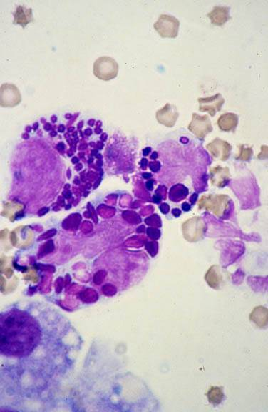
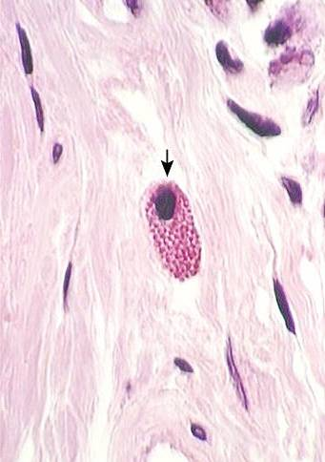
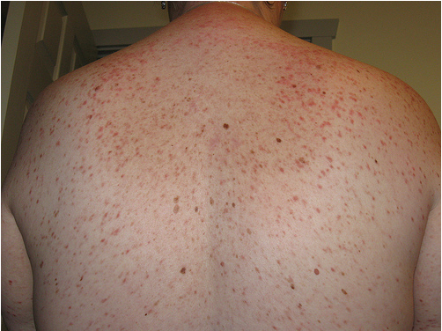
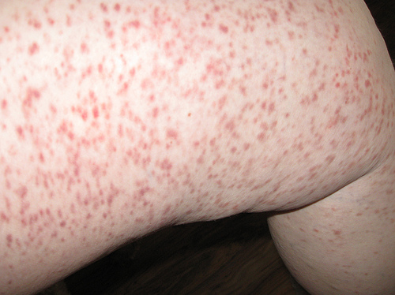
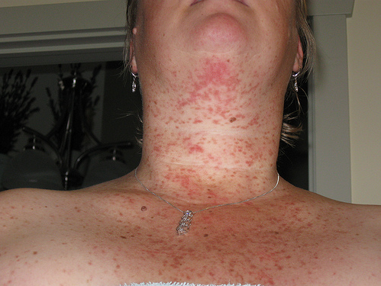
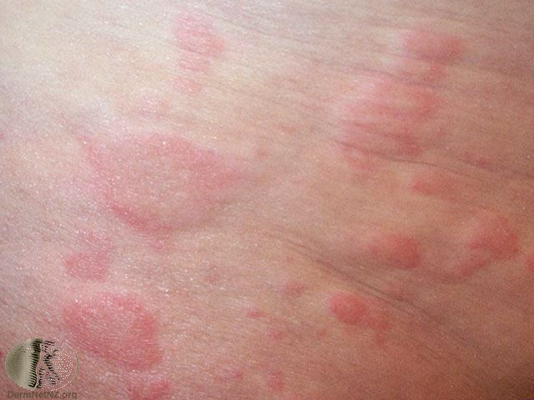
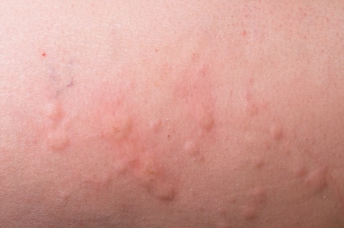
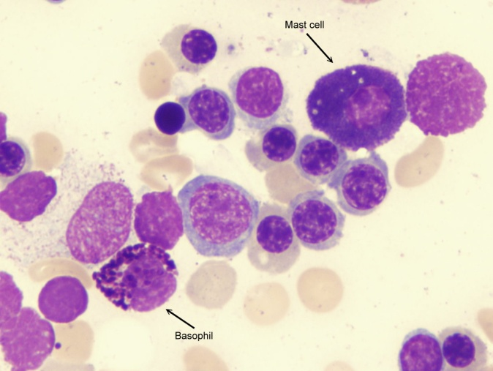
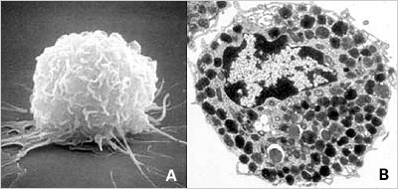
Mastocytosis: A Long History
1869: Urticaria pigmentosa (UP) first described
1877: First description of the mastzelle
1887: UP linked with mastzelles
1933: Suggestion of linkage with internal dz
1939: MC heparin identified
1949: Definitive linkage with systemic dz
1953: MC histamine identified
1987: MC tryptase identified
1988: Travis classification
1995: KIT activating mutation D816V identified
1998: Unique flow cytometric signature found
  CD117 + (CD25 and/or CD2)
2001: WHO classification and imatinib
MC neoplasia is morbid only in rare, aggressive forms; MC activation is what causes symptoms

Slide 6
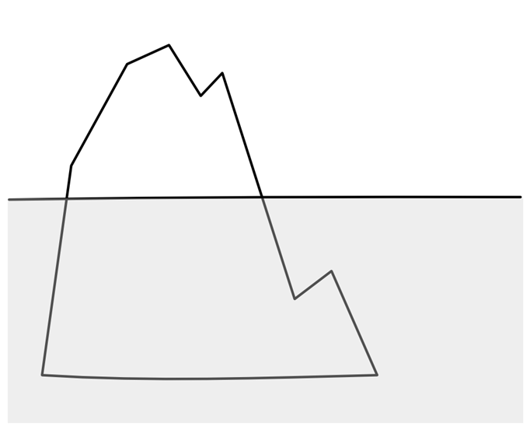
Prevalence of SM: ~1:100,000
Prevalence of MCL: ~1:10,000,000
Mast Cell Leukemia
Prevalence of CM: ~1:10,000
Aggressive Systemic Mastocytosis
Telangiectasia macularis
Systemic mastocytosis with associated
eruptiva perstans
hematologic non-mast-cell-lineage disorder
Mastocytoma
Systemic
Mastocytosis
Smoldering Systemic Mastocytosis
Diffuse Cutaneous
Indolent Systemic Mastocytosis
~70-90% of all SM
Mastocytosis
Disorders also featuring inappropriate mast cell
proliferation
Urticaria
Pigmentosa
Cutaneous
Mastocytosis
Disorders featuring inappropriate mast cell
activation
Prevalence of urticaria:
~1:10
Urticarias and
Angioedema
Allergies and
Anaphylaxis
Prevalence of allergy:
~1:5
Mast Cell
Activation
Syndromes
Not Yet Otherwise Classified
The Spectrum of
Mast Cell Disease
We’ve Long Known

Slide 7
MCAD: A Brief History
1991: 1st published hypothesis that MCAS ought to exist
2007: 1st case reports of MCAS
  Some with KIT-D816V, some without
2007: 1st study showing other KIT mutations in most MCAS (Bonn)
2008-: Non-KIT mast cell regulatory gene mutations found in SM
2010: 2nd study showing KIT mutations in most MCAS (Bonn)
  KIT-D816V rare
  Few mutations in controls
2010: Proposal of “MCAD” (Harvard, Vienna, NIH)
  Includes 1st proposal for MCAS dx criteria
2011: Alternative proposal for MCAS dx criteria (Bonn, MUSC)
2012: Revised (Vienna et al.) proposal for MCAS dx criteria
  Still many problems
2016: Revised WHO diagnostic criteria for SM
  Mastocytosis now separate from the myeloproliferative neoplasms (MPNs)
  “Smoldering SM” added; “SM-AHNMD” shortened to “SM-AHN”
  No statement regarding MCAS

Slide 8
MCAD: Emerging Understanding
Mast Cell Leukemia
Aggressive Systemic Mastocytosis
Telangiectasia macularis
Systemic mastocytosis with associated
eruptiva perstans
hematologic non-mast-cell-lineage disorder
Mastocytoma
Systemic
Mastocytosis
Smoldering Systemic Mastocytosis
Diffuse Cutaneous
Indolent Systemic Mastocytosis
Mastocytosis
Disorders also featuring inappropriate mast cell
proliferation
Urticaria
Pigmentosa
Cutaneous
Mastocytosis
Urticarias and
Angioedema
Allergies and
Anaphylaxis
Disorders featuring inappropriate mast cell
activation
Mast Cell
Activation
Syndromes
Not Yet Otherwise Classified

Slide 9

Mast Cell Activation Disease
Mast Cell Leukemia
0.0000001%?
Aggressive Systemic Mastocytosis
Increasing prevalence
SM-AHNMD
Indolent Systemic Mastocytosis
Cutaneous Mastocytosis
Mast Cell Activation Syndrome
17%?

Slide 10
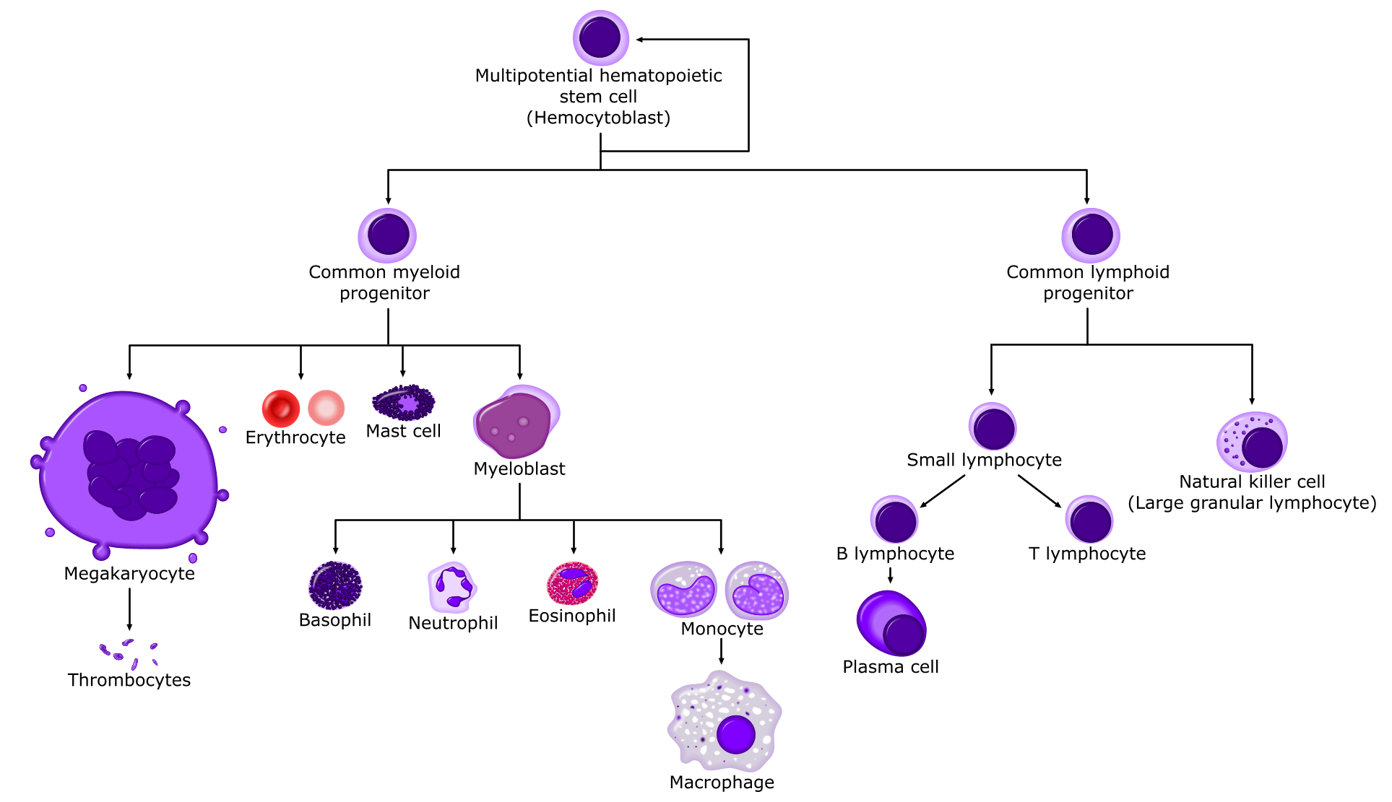
Normal mast cell biology
From allthingsstemcell.com

Slide 11
Normal mast cell biology
Hematopoietic origin, brief circulation
  Normally 0.05% of marrow nucleated cells
  Typically < 2% even in systemic mastocytosis
  Unique flow cytometric signature (incl. CD117+, CD25/2-)
Maturation completed in all vascularized tissues
  Especially abundant beneath environmentally exposed mucosal/epithelial surfaces and adjacent to blood and lymphatic vessels and nerves, permitting sentinel function
Relatively immobile once localized in peripheral tissue
Lifespan typically several months to a few years
Kalesnikoff J, Galli SJ. New developments in mast cell biology. Nature Immunology 2008;9:1215-23.
Ribatti D. The development of human mast cells: an historical reappraisal. Exp Cell Res 2016;342(2):210-5.

Slide 12
Normal mast cell biology
Functions (when appropriately stimulated):
  Synthesize active substances
    Some stored in granules of highly heterogeneous content
  Release various mediators upon various triggerings
  Phagocytose particulate material including bacteria, erythrocytes, schistosomes, metals, etc.
KIT stem cell factor receptor and tyrosine kinase (on 4q11-12) is expressed at high levels on the mastocyte surface
  Critical for many mast cell functions including survival, differentiation, chemotaxis, and activation
Akin C, Metcalfe DD. The biology of Kit in disease and the application of pharmacogenetics. J Allergy Clin Immunol 2004; 114:13–19.
Gordon JR et al. Mast cells as a source of multifunctional cytokines. Immunol Today 1990;11:458.
Bradding P et al. Heterogeneity of human mast cells based on cytokine content. J Immunol 1995; 155:297.

Slide 13
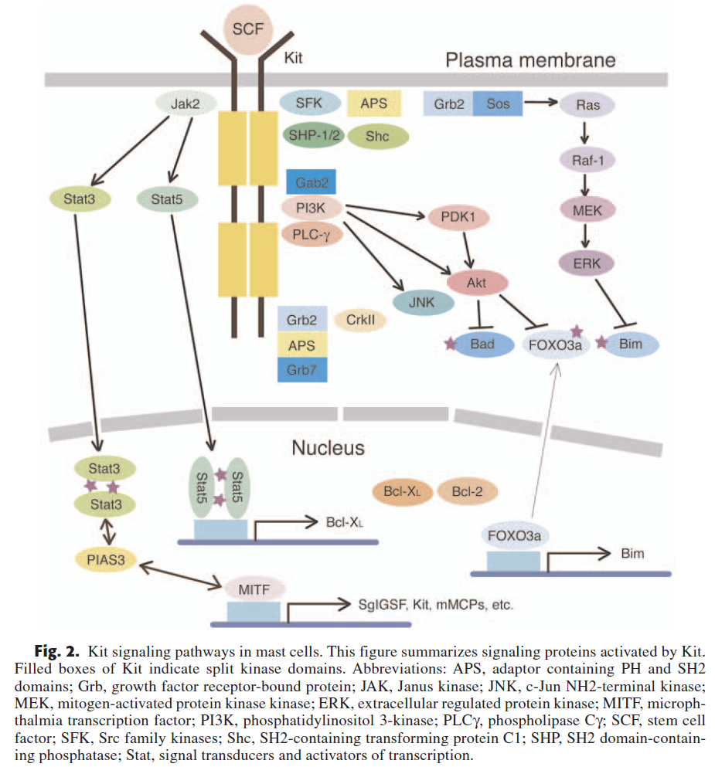
Okayama Y, Kawakami T. Development, migration, and survival of mast cells. Immunologic Research 2006;34(2):97-115.

Slide 14
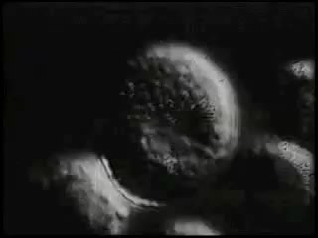
Normal mast cell biology
Many triggers
  Classic: Adjacent high-affinity IgE receptors (FcεRI) with bound IgE get crosslinked by polyvalent antigen
  Physical stimuli: Pressure/trauma, heat, cold, UV, etc.
  Many other receptors for: histamine (H1/H2/H3/H4), SCF, IgG, C3a, C5a, PAF, CRF, neuropeptides (VIP, substance P, somatostatin, etc.), opioids, paralytics, benzodiazepines, cannabinoids, etc. etc. etc.
  Also many of the Toll-like receptors (affinities for various microbial proteins)
Bischoff SC et al. J Exp Med 1992;175:237.
Theoharides TC et al. Trends Pharmacol Sci 2008;29:375–382.
Conrad DH et al. J Immunol 1975;114:1688.
Woolhiser MR et al. Eur J Immunol 2001;31:3298.
Nilsson G et al. J Immunol 1996;157:1693.
Marshall JS et al. Int Arch Allergy Immunol 2003;132:87.
Church MK et al. Int Arch Allergy Appl Immunol 1991;94:310.
Stellato C et al. Anesthesiology 1991;74:1078.
Moss J et al. Anesthesiology 1983;59:330.
Miller LG et al. Pharmacology 1988;36:52–60.
Samson M-T et al. J Immunol 2003;170:4953-4962.
Kajiwara N et al. J Allergy Clin Immunol 2010;125:1137.
Theoharides TC, et al. New Engl J Med 2015;373:163-72.

Slide 15
Normal mast cell biology
Capable of synthesizing and releasing many mediators
  Many expressible at very high levels
  Some stored in fully active form in electron-dense secretory granules, tightly packaged with serglycin proteoglycans
  A small sample:
  Pro-inflammatory cytokines
    IL-1α, IL-1β, IL-2, IL-4, IL-5, IL-6, IL-7, IL-9, IL-10, IL-12, IL-13, IL-15, IL-16, IL-18, IL-21, IL-23, IL-25, IFN-γ, TNF-α
  Chemokines
    MCP-1, IL-8, RANTES, eotaxin, leukotrienes B₄, C₄, D₄, E₄ (SRS-A), CCL2, CCL3, CCL4, CCL5, CCL11, CCL19, CCL20, CCL21, CXCL8, CXCL10, XCL-1
  Proteases
    Tryptase, chymase, ACE, carboxypeptidase, cathepsin G, cysteinyl cathepsins, metalloproteinases
  Growth factors
    IL-3, GM-CSF, bFGF, VEGF, TGF-β, PDGF, EGF, NGF, SCF, angiopoietin
  Vascular permeability, vasodilatation
    Histamine, 5-hydroxytryptamine, tryptase, NO, VLA4
  Platelet aggregation and thrombosis:
    PAF, thromboxane
  Heparin proteoglycan
  Chondroitin sulfate proteoglycan
  Superoxide dismutase
  Acid hydrolases
    Glucuronidase, galactosidase, hexosaminidase, peroxidase
  Arylsulphatase A
  Prostaglandin D₂, thromboxane
  Serotonin
  Antimicrobial agents
    IFN-α, IFN-β, IFN-γ, cathelicidin, LL-37
  CRH
  TSLP
  Want more? See http://www.cells-talk.com/index.php/page/copelibrary?key=mast%20cells
Theoharides TC et al. Differential release of mast cell mediators and the pathogenesis of inflammation. Immunological Reviews 2007;217(1):65-78.

Slide 16
Criteria for Systemic Mastocytosis
  WHO ’16: Indol. SM, smold. SM, SM-AHN, aggressive SM, MC leukemia
  1 major + 1 minor, or 3+ minor criteria
  Only major criterion: “Multifocal, dense infiltrates of mast cells consisting of 15 or more mast cells in aggregates detected in sections of bone marrow and/or other extracutaneous organs, confirmed by tryptase immunohistochemistry or other special stains”
  4 minor criteria:
    More than 25% of MCs in biopsy sections or bone marrow aspirate smears showing spindle shape or atypical morphology
    Expression of CD2 and/or CD25 by marrow, blood, or extracutaneous organs MCs
    KIT codon 816 mutation in bone marrow, blood, or other extracutaneous organs
      Different KIT mutations → different phenotypes
        D816V: MC clusters, spindle forms, expression of CD25, histamine, CPA, etc.
        Extracellular domain: AKT activation
    Serum total tryptase (25% of MC protein!) persistently > 20 ng/ml
Arber DA et al. The 2016 revision to the World Health Organization classification of myeloid neoplasms and acute leukemia. Blood 2016;127:2391-2405.
Mayerhofer M et al. Unique effects of KIT D816V in BaF3 cells: induction of cluster formation, histamine synthesis, and early mast cell differentiation antigens. J Immunol 2008;180:5466-5476.
Teodosio C et al. Mast cells from different molecular and prognostic subtypes of systemic mastocytosis display distinct immunophenotypes. J Allergy Clin Immunol 2010;125:719-726.e4.
Yang Y et al. Pediatric mastocytosis-associated KIT extracellular domain mutations exhibit different functional and signaling properties… Blood 2010 Aug 19, 116(7):1114-1123.
Alvarez-Twose I et al. Clinical, biological, and molecular characteristics of clonal mast cell disorders presenting with systemic mast cell activation symptoms. J Allergy Clin Immunol 2010;125:1269-1278.e2.
Schwartz LB et al. Quantitation of histamine, tryptase, and chymase in dispersed human T and TC mast cells. J Immunol 1987;138(8):2611-2615.

Slide 17

The Problem
Chronic Fatigue Syndrome!
Fibromyalgia!
POTS!
Refractory
GERD!
Just Old
Age!
Granuloma Annulare, or Chronic
Inflammatory Demyelinating
Polyneuropathy, or…or…or…!

Slide 18

What to do when it behaves like mast cell disease but isn’t allergic disease or mastocytosis:
Consider mast cell activation syndrome

Slide 19
Proposed Criteria for MCAS
Self-described “consensus” proposal
  Problem: Methods by which “consensus” was obtained
  History consistent with chronic and/or recurrent aberrant mast cell mediator release
    Problem: Few symptoms listed in proposal (e.g., flushing)
  Not SM and no better-fitting disease
  Rise in tryptase (within 4h of flare) of 20% + 2 ng/ml over asymptomatic baseline
    Problem: establishing “asymptomatic” baseline
    Problem: getting blood for tryptase level drawn within 4h of flare
    Problem: allows levels well within normal range to signify disease
    Problem: no published data whether this distinguishes nl./abnl. fluctuation
  Response to mast cell-targeted therapy
    Problem: requires therapy prior to diagnosis
    Problem: should diagnosis of this very heterogeneous disease be ruled out if 1 or 2 lines of empiric therapy fail?
Valent P et al. Definitions, criteria and global classification of mast cell disorders with special reference to mast cell activation syndromes: a consensus proposal. Int Arch Allergy Immunol 2012 Jan;157:215-225.
Akin C et al. Mast cell activation syndrome: proposed diagnostic criteria. J Allergy Clin Immunol 2010; 126:1099-1104.e4.

Slide 20
Proposed Criteria for MCAS
Alternative proposal (structure similar to WHO criteria for SM):
  Major criteria:
    Multifocal or disseminated dense infiltrates of mast cells in bone marrow biopsies and/or in sections of other extracutaneous organ(s) (e.g., gastrointestinal tract biopsies; CD117-, tryptase- and CD25-stained)
    Unique constellation of clinical complaints as a result of a pathologically increased mast cell activity (mast cell mediator release syndrome)
  Minor criteria:
    Mast cells in bone marrow or other extracutaneous organ(s) show an abnormal morphology (>25%) in bone marrow smears or in histologies
    Mast cells in bone marrow express CD2 and/or CD25
    Detection of genetic changes in mast cells from blood, bone marrow or extracutaneous organs for which an impact on the state of activity of affected mast cells in terms of an increased activity has been proven.
    Evidence of a pathologically increased release of mast cell mediators (serum tryptase, urinary N-methylhistamine, plasma heparin, serum chromogranin A, or other mast cell-specific mediators (e.g., leukotrienes, prostaglandin D₂))
  Diagnosis made when either both major criteria, or second major criterion + at least one minor criterion, or any three minor criteria are met…
    …and no other diagnosis that better accounts for the full range and duration of all the symptoms and findings in the history, exam, and labs
Same as WHO
New
Same as WHO
Same as WHO
Expanded
Expanded
Molderings G, et al. Mast cell activation disease: a concise practical guide for diagnostic workup and therapeutic options. J Hematol Oncol 2011;4:10.

Slide 21
MCAS: Emerging Understanding
Increasing estimates of prevalence
  1-17% of the general first-world population?
Increasing evidence of critical mast cell involvement in…
If MCAS dominantly manifests as chronic inflammatory disease (CID), might its prevalence be even higher within populations enriched for CID
(e.g., inpatients)?
Est. Global Prev.
Est. Global Prev.
  Asthma (4-20%)
  Obesity (37%)
  Depression (5%)
  Atherosclerosis (?)
  Etc. etc. etc. etc.
  Irritable bowel syndrome (11%)
  Chronic fatigue syndrome (3%)
  Fibromyalgia (1-10%)
  Diabetes mellitus (2-20%)
  Asthma
  Obesity
  Depression
  Atherosclerosis
  Etc. etc. etc. etc.
  Irritable bowel syndrome
  Chronic fatigue syndrome
  Fibromyalgia
  Diabetes mellitus
What Portions of These Populations Bear Clonal Mast Cell Disease?
Theoharides TC. Clin Ther 2013;35:544-7.
Afrin LB. Oral Surg Oral Med Oral Path Oral Radiol Endodontol 2011;111:465-472.
Haenisch B, et al. Immunol 2012;137:197-205.
Pejler G, et al. Blood 2010;115(24):4981-4990.
Theoharides TC, et al. Biochim Biophys Acta 2012 Jan;1822(1):21-33.
Theoharides TC, et al. Trends Pharmacol Sci 2011;32(9):534-542.
Brightling CE, et al. Curr Allergy Asthma Reports 2005;5:130-135.
Blanco I, et al. Clin Rheumatol 2010;29:1403-1412.
Theoharides TC, et al. J Clin Psychopharmacol 2005;25:515-520.
Theoharides TC, et al. J Clin Psychopharmacol 2004;24:577-581.
Molderings GJ, et al. PLoS One 2013;8(9):e76241
Frieling T, et al., Z Gastroenterol 2011;49:191-194.

Slide 22
MCAS: Emerging Biology
May be clonal in most cases…
  More than 50 mutations (mostly heterozygous, but still functionally dominant) found scattered across all domains of KIT
  Most patients have multiple KIT (and other) mutations
  No commercial assays yet for most of these mutations
…but not yet independently confirmed…
…thus issue of “non-clonal” vs. “undetermined clonality”
  Readily available genome/exome sequencing may resolve this soon
Molderings GJ et al. Multiple novel alterations in Kit tyrosine kinase in patients with gastrointestinally pronounced systemic mast cell activation disorder. Scand J Gastroenterol 2007; 42(9):1045-1053.
Molderings GJ et al. Comparative analysis of mutation of tyrosine kinase Kit in mast cells from patients with systemic mast cell activation syndrome and healthy subjects. Immunogenetics 2010;62:721-727.

Slide 23
MCAS: Emerging Biology
KIT mutations found thus far in MCAS:
    Ligand-binding domain: W8R, C12S, del(nt a153), E53K, insertion 71 ?seq(400bp), E73R, T74R, exon 3 & 5 del and ins/del, ins nt 248a, ins Q252, K259E, H265Q, E270K, L276S
    Dimerization domain: E338K, Q346L, M351E, F355L, E359V, exon 7 ins/del, del (aa 378-390)
    Proteolytic cleavage site: L416Q, D419H, ins(nt 1282g), exon 8 del
    Membrane-spanning region: del 510-513, exon 10 ins, M541L
    Juxtamembrane (autoinhibitory) region: F584C
    Kinase insert sequence K1: S709A, del(S715), A736V, D751Y
    Kinase domain K2: F782S, N787D, H790R, D816V (rare!), S821F, A829T, A837V, L862V
    C-terminus: complex insertions
Molderings GJ et al. Multiple novel alterations in Kit tyrosine kinase in patients with gastrointestinally pronounced systemic mast cell activation disorder. Scand J Gastroenterol 2007; 42(9):1045-1053.
Molderings GJ et al. Comparative analysis of mutation of tyrosine kinase Kit in mast cells from patients with systemic mast cell activation syndrome and healthy subjects. Immunogenetics 2010;62:721-727.

Slide 24




MCAS: Do the Biology Math
MCs produce and release scores of mediators
1 mutation ⇒ aberrant release of N mediators
Multiple KIT mutations in most MCAS patients?
Multiple genes mutated in most MCAS patients?
Each mediator has its own unique array of direct and indirect, local and remote effects

Slide 25
MCAS: Presentation
Typical presentation
  Age of onset: typically < 20 but unrecognized for decades
  Usually multisystem; can affect every system
  Symptoms often (but not always) “inflammatory”
  Perplexingly inconstant course:
    Abnormalities often externally inapparent (“she looks fine!”)
    Chronic or waxing/waning or episodic (“flares”, “spells”)
    Different symptoms at different times
    Often no apparent triggers
  Mediators:
    Tryptase (total & mature) usually normal (reflects MC load >> activation)
    Heparin, CGA, PGD₂ and histamine (& metabolites), LTE4 often elevated
  Many MDs, many dx’s (often non-specific, idiopathic, “somatic”)
  Patients commonly cease reporting symptoms – ROS important!
1. Afrin LB, Butterfield JH, Martin R, Molderings GJ. Ann Med 2016;48(3):190-201.
2. Zenker N, Afrin LB. Blood 2015;126:5174.
3. Schwartz LB. J Immunol 2003;170(11):5667-73 and Immunol Allergy Clin N Am 2006;26:451-63.
4. Hamilton MJ et al. J Allergy Clin Immunol 2011;128;147-52.
4. Vysniauskaite M et al. PLoS One 2015 Apr 24;10(4):e0124912.
5. Ferrer M et al. Clin Exp Allergy 2010 Dec;40(12):1760-6.
6. Sala-Cunill A et al. Int Arch Allergy Immunol 2013;160(2):192-9.

Slide 26
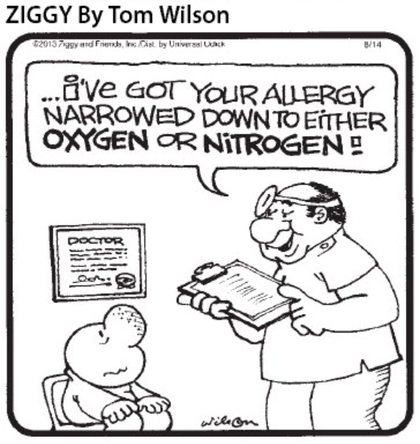
MCAS: Presentation
Constitutional
  Fever, chills, fatigue, sweats, weight ↑ or ↓ or ↑↓, pruritus
  Odd and prolific sensitivities (drugs, foods, environs)
Eyes
  Irritation, episodic inability to focus vision, blepharospasm
Ears
  Irritation, hearing deficit and/or tinnitus
Nose
  Irritation, sores, epistaxis, coryza
Oral/esophageal
  Irritation, sores, dysphagia, globus
Afrin LB, Butterfield JH, Martin R, Molderings GJ. Ann Med 2016;48(3):190-201.

Slide 27
MCAS: Presentation
Nodes
  Borderline pathologic, waxing/waning, migratory adenopathy
  Left upper quadrant (splenic?) discomfort common
  Path: usually reactive lymphocytosis, occ. sinus histiocytosis
Pulmonary
  Waxing/waning migratory edema/inflammation (e.g., cough)
  Dyspnea (normal PFTs; “I just can’t catch a deep breath”)
Cardiovascular
  Unprovoked presyncope/syncope, labile BP/pulse, palpitations
  Chest pain: coronaries usually clean, but occ. aggressive CAD
  Arterial, venous malformations; episodic migratory edema
  Takotsubo (acute balloon CHF), Kounis (allergic angina) synd.
Afrin LB, Butterfield JH, Martin R, Molderings GJ. Ann Med 2016;48(3):190-201.

Slide 28
MCAS: Presentation
GI
  Inflammation (any/all luminal segments, solid organs)
  Refractory GERD, IBS, mild ↑LFTs common
  Diarrhea  constipation
  Queasiness, nausea, vomiting (sometimes “cyclical”)
  Malabsorption common (gen., or selected micronutrients)
  Hepatic involvement common, usually inflamm./fibrosis
GU
  Inflammation (any/all luminal segments, solid organs)
    e.g., “interstitial cystitis”
  ↓ libido, infertility
Afrin LB, Butterfield JH, Martin R, Molderings GJ. Ann Med 2016;48(3):190-201.

Slide 29
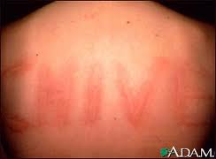
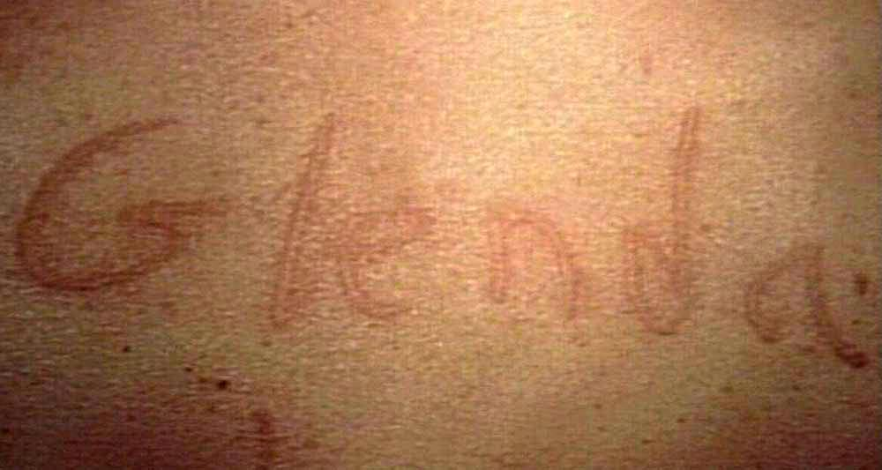
MCAS: Presentation
Musculoskeletal and Joints
  Myositis, osteopenia and/or osteosclerosis
  Diffusely migratory soft tissue pain; “fibromyalgia,” “CRPS”
    NSAIDs/narcs often unhelpful (may trigger flares!)
Skin/Integument
  Lesions (many types), rashes (many types, often migratory), pruritus, flushing, angioedema, dermatographism
  Hair/nail/dental dystrophy
CNS
  Headache, vertigo, syncope, tic/tremor, weakness, dysautonomia
  Migratory paresthesias, insomnia very common
  Wide range of psychiatric disorders also found in MCAD
Afrin LB, Butterfield JH, Martin R, Molderings GJ. Ann Med 2016;48(3):190-201.

Slide 30
MCAS: Presentation
Heme
  Counts often normal, or…
    ↑ or ↓ H/H (subtle ↑ RDW, MCH common)
    ↑ or ↓ WBC (subtle/intermit. ↑ monos, eos, &/or basos common)
    ↑ or ↓ plts
    ↑ or ↓ clotting
  Marrow
    Usually normal (histology, IHC, cytogenetics, flow, PCR)
    Most common abnormality: mild dysplasia (“unclass. MDS/MPN”)
Immunity
  Hypersensitivities, ↑ risk for malig., autoimm., infection
  Poor healing
Afrin LB, Butterfield JH, Martin R, Molderings GJ. Ann Med 2016;48(3):190-201.

Slide 31
MCAS: Presentation
Endocrinologic/metabolic
  Delayed puberty/menarche, dysmenorrhea, endometriosis
  Osteopenia/osteoporosis, osteosclerosis
  Hypo/hyperthyroidism, hyperferritinemia (inflammatory)
  ↑ or ↓ electrolytes, ↑ lipids (often hypertriglyceridemia)
Afrin LB, Butterfield JH, Martin R, Molderings GJ. Ann Med 2016;48(3):190-201.

Slide 32
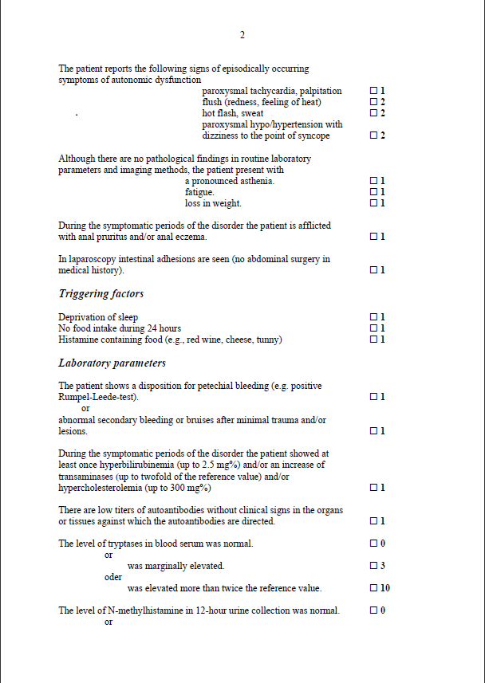
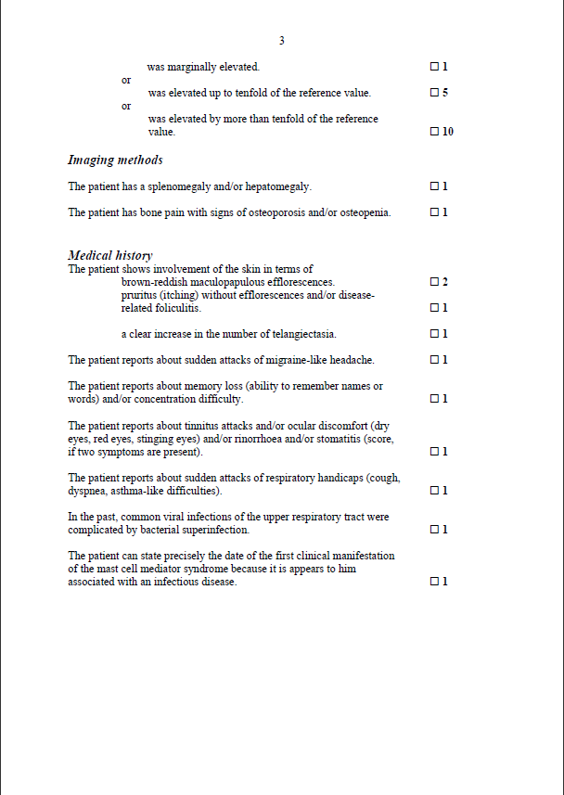
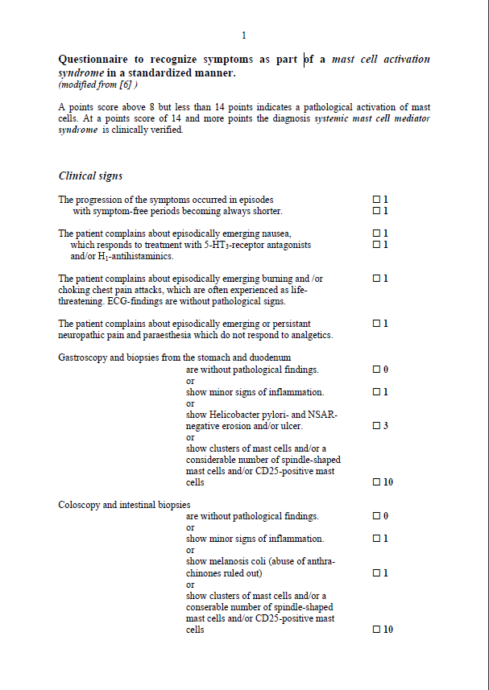
MCAS: Diagnosis
Traditional diagnostic paradigm (symptom A + exam finding B + test result C ⇒ suspect diagnosis D) doesn’t work for MCAS
Instead, need to recognize either of two “metapatterns”:
  Multiple chr. inflamm. ills often unsatisfactorily responsive to R_{x}
  Definitively diagnosed ailment which doesn’t explain all of the symptoms, findings, and results
Questionnaires? EMRs?
Molderings G et al. Die systemische Mastzellerkrankung mit gastrointestinal betonter Symptomatik - eine Checkliste als Diagnoseinstrument. Deutsche medizinische Wochenschrift 2006 Sep 22; 131(38):2095-100.
Alfter K et al. New aspects of liver abnormalities as part of the systemic mast cell activation syndrome. Liver International 2010;29(2):181-186.

Slide 33

MCAS: Diagnosis
Best diagnostic aids:
  Most physicians’ best friend: a complete history and exam
  Faith in Occam’s Razor: which scenario is more likely?
    Multiple diagnoses/problems all independent of each other
    vs.
    One diagnosis that’s biologically capable of causing most or all of the findings (i.e., the simplest solution, even if it’s not the most immediately obvious solution)

Slide 34
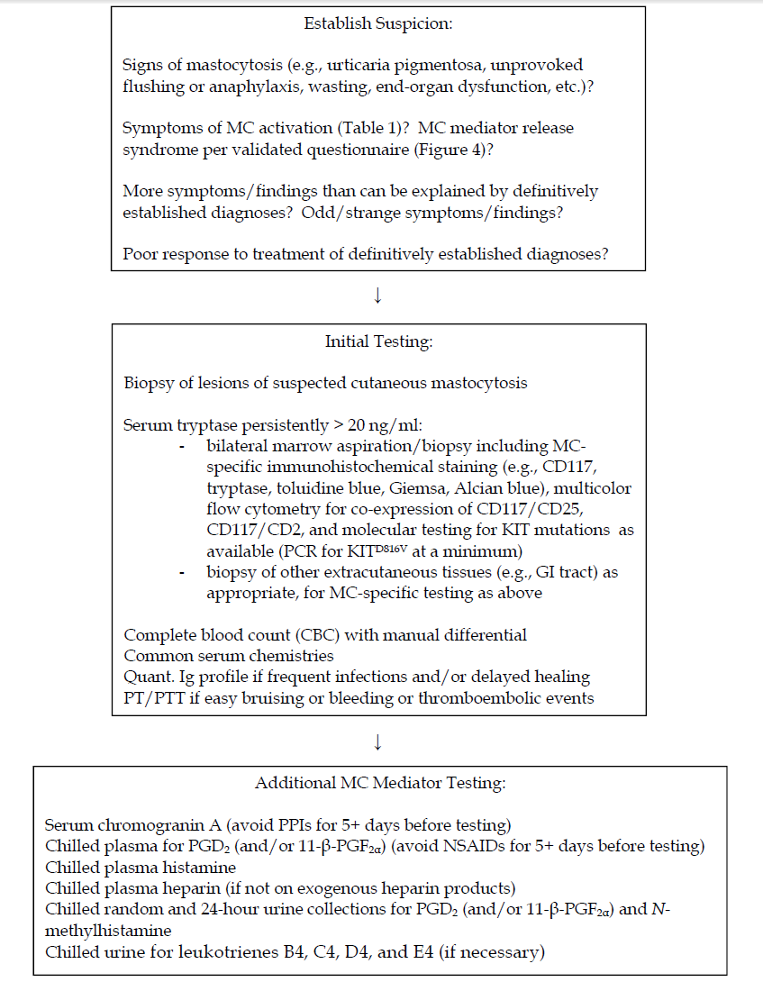
MCAS
Diagnostic
Work-Up:
2016
Afrin LB, Molderings GJ. A concise, practical guide to diagnostic assessment for mast cell activation disease. World J Hematol 2014 Mar;3(1):1-17.

Slide 35
MCAS: Prognosis
No epidemiologic studies of prognosis yet
Present gestalt impression:
  After the first three years, survival curves parallel the general population (similar to indolent systemic mastocytosis)
So, like allergic diseases and ISM, reduced survival is a relatively small problem in MCAS, and instead most suffer reduced QoL (anywhere from mild to severe, variable over time) until the disease is accurately diagnosed and effectively controlled
Many therapies (targeting many receptors and pathways) found helpful in various MCAD/MCAS patients
  Cytotoxic chemotherapy unlikely to help MCAS
Most pts eventually identify a significantly helpful regimen
Roberts LJ, Anthony LB, Oates JA. “Disorders of Vasodilator Hormones: Carcinoid Syndrome and Mastocytosis” in Wilson JD, Foster DW, Kronenberg HM, et al., eds., Williams Textbook of Endocrinology, 9th ed., 1998, W. B. Saunders Company, Philadelphia, pp. 1718-1732.
Lim K-H, et al. Systemic mastocytosis in 342 consecutive adults: survival studies and prognostic factors. Blood 2009;113:5727-5736.

Slide 36
MCAS: Treatment
2016: Largely as for indolent mastocytosis
  Identify and avoid triggers
  Inhibit mediator production
  Inhibit mediator release
  Block actions of released mediators
  Cytotoxic and cellular therapy only for aggressive SM, MCL
  Secondary issues and comorbidities

Slide 37
MCAS: Treatment
2016: Largely as for indolent mastocytosis
  Identify and avoid triggers (antigenic and physical)
    Or try desensitization therapy if feasible
    Be aware: medication excipients often are prominent triggers
      Trying alternative (commercial or compounded) formulations often necessary
  Inhibit mediator production
  Inhibit mediator release
  Block actions of released mediators
  Cytotoxic and cellular therapy only for aggressive SM, MCL
  Secondary issues and comorbidities

Slide 38
MCAS: Treatment
2016: As for mastocytosis
  Identify and avoid triggers
  Inhibition of mediator production
    Steroids, NSAIDs
    Vitamin C
    Possibly also hydroxyurea (or even IMiDs?)
  Inhibition of mediator release (stabilization)
  Blockade of released mediators
  Rarely (if ever): Cytotoxic therapy
  Hypothetical: Cellular therapy
  Secondary issues and comorbidities

Slide 39
MCAS: Treatment
2016: As for mastocytosis
  Identify and avoid triggers
  Inhibition of mediator production
  Inhibition of mediator release (stabilization)
    Cromolyn (oral and/or inhaled – non-absorbed)
      Can trigger flares 1st few days; tachyphylaxis can abrogate efficacy
    Pentosan (especially for interstitial cystitis)
    Tyrosine kinase inhibitors
    Interferon (& pegylated form?)
    Omalizumab (anti-IgE)
    Azathioprine or other ISTs
    mTOR inhibitors?
    Benzodiazepines and imidazopyridines
      e.g., lorazepam, clonazepam, flunitrazepam, zolpidem
  Blockade of released mediators
  Rarely (if ever): Cytotoxic therapy
  Hypothetical: Cellular therapy
  Secondary issues and comorbidities
Imatinib (FDA approved for CML, mastocytosis)
Dasatinib (FDA approved for CML)
Nilotinib (FDA approved for CML)
Sunitinib (FDA approved for renal cell Ca & GIST)
Midostaurin (investigational)
Masitinib (investigational)

Slide 40
MCAS: Treatment
2016: As for mastocytosis
  Identify and avoid triggers
  Inhibition of mediator production
  Inhibition of mediator release (stabilization)
  Blockade of released mediators
    Antihistamines (even cont. IV diphenhydramine in severely afflicted pts)
      Often impressive benefits even absent rhinosinusitis and dyspepsia
      Can also stabilize mast cells via their autoexcitatory H₁/H₂ receptors
    Leukotriene antagonists
    Calcium/vit. D, bisphosphonates, denosumab for osteoporosis/osteopenia
    TNF antagonists (etanercept, adalimumab, infliximab)?
    IL-1 antagonists (e.g., anakinra), IL-1β antagonists (e.g., canakinumab)?
    In development: inhibitors of tryptase, chymase, H₃ receptors, etc. etc.
  Rarely (if ever): Cytotoxic therapy
  Hypothetical: Cellular therapy
  Secondary issues and comorbidities

Slide 41
MCAS: Treatment
2016: As for mastocytosis
  Identify and avoid triggers
  Inhibition of mediator production
  Inhibition of mediator release (stabilization)
  Blockade of released mediators
  Rarely (if ever): Cytotoxic therapy
    Hydroxyurea, alkylators, taxanes, etc.
    Fludarabine, cladribine, cytarabine, etc.
    Alemtuzumab, daclizumab
  Hypothetical: Cellular therapy
  Secondary issues and comorbidities

Slide 42
MCAS: Treatment
2016: As for mastocytosis
  Identify and avoid triggers
  Inhibition of mediator production
  Inhibition of mediator release (stabilization)
  Blockade of released mediators
  Rarely (if ever): Cytotoxic therapy
  Hypothetical: Cellular therapy
    Allogeneic stem cell transplantation
  Secondary issues and comorbidities

Slide 43
MCAS: Treatment
2016: As for mastocytosis
  Inhibition of mediator production
  Inhibition of mediator release (stabilization)
  Blockade of released mediators
  Rarely (if ever): Cytotoxic therapy
  Hypothetical: Cellular therapy
  Treatment of secondary issues
    Frequent mistake by patients and providers: Assuming a symptom (new or old, chronic or acute) is directly due to MCAS
      MCAS does not render one immune to developing other disease
      Regardless of the likelihood that a symptom may ultimately stem from MCAS, rule out other reasonable diagnostic considerations before assuming MCAS is the (direct) cause!
    Illnesses secondary to mast cell disease require full treatment until the mast cell disease is controlled, and even then…
    “…the horse is sometimes already out of the barn”: malignancy and autoimmunity rarely, if ever, spontaneously remit simply with control of the underlying mast cell disease

Slide 44
MCAD: Research at UMN
Completed or in progress:
  Characterization of a Large MCAS Population
  Utility of Various Mediators in Diagnosing MCAS
  Confirmation/Extension of Clonality in MCAS
  Genomic Profiling of Urticaria Pigmentosa
  Mast Cell Disease in Chronic GI Tract Graft Vs. Host Disease
Proposals Actively in Development:
  GWAS in MCAD
  Masitinib in MCAS
  MCAD in Dercum’s Disease (collaboration with U. Arizona)

Slide 45
MCAD: Other Research Ideas
Characterization of Mast Cell Regulatory Gene Mutations in MCAS
MCAD in Refractory GERD
MCAD in Asthma
MCAD in Obesity
MCAD in Fibromyalgia
MCAD in Chronic Fatigue Syndrome
MCAD in Irritable Bowel Syndrome
MCAD in Ehlers-Danlos Syndrome Type III
MCAD in Postural Orthostatic Tachycardia Syndrome
MCAD in Atherosclerotic Vascular Disease
MCAD in Gulf War Illness
MCAD as a Significant Modifier in Sickle Cell Disease
Etc. etc. etc. etc.

Slide 46
MCAD: What’s next?
RESEARCH
  Improved diagnostic techniques
    Early genomic sequencing of isolated mast cells to distinguish primary from secondary disease and identify mutational patterns correlating with various clinical presentations?
  Etiology
    Environmental? Genetic? Epigenetic? Viral?
  Therapy
    Predictive biomarkers
    Targeted therapies
EDUCATION (providers, payers, patients, grantors)

Slide 47
UMN Mast Cell Disease Program:
A Multidisciplinary Team
Hem/Onc:
  Larry Afrin, MD
  Cela Ustun, MD
  Greg Vercellotti, MD
  Kalpna Gupta, PhD
Peds Hem/Onc:
  Lucie Turcotte, MD
Peds Derm:
  Sheilagh Maguiness, MD
Allergy:
  Doug McMahon, MD
  Michael Wexler, MD
Dermatology:
  Dan Miller, MD
GI:
  Alex Khoruts, MD
ED:
  Greg Loppnow, MD
Endocrinology:
  Tasma Harindhanavudhi, MD
Pulmonary:
  Erhan Dincer, MD
Community Medicine
  Greg Plotnikoff, MD
Anesthesiology:
  Elif Cingi, MD
Radiology:
  Zuzan Cayci, MD
Pathology:
  Sophia Yohe, MD
  Michael Linden, MD
  Mahmoud Khalifa, MD
Lab Medicine:
  Tony Killeen, MD, PhD
  Amy Saenger, PhD
Clinical Laboratory:
  Karri Cargill, MLS
Genetics Informatics:
  Kevin Silverstein, PhD
  Lauren Mills, PhD
  Christy Henzler, PhD
Pharmacology & Precision Medicine:
  Pam Jacobson, PharmD
Epidemiology:
  Heather Nelson, PhD
Veterinary Clinical Sciences
  Michael Henson, DVM, PhD
Clinical Support:
  Maureen Collins-Fuchs, RN
  Lucy Reinhardt, P.A.
  Countless others…
http://mastcell.umn.edu

Slide 48



Summary
MCAD Diagnostic Class | General Prevalence | Phenotype | Tryptase usually…
Allergic Diseases | Prevalent | Allergy ± Inflammation | Normal
Mastocytosis | Rare | Allergy & MC Neoplasia ± Inflamm. | Elevated
MCAS | Prevalent | Inflammation ± Allergy | Normal
Tryptase dominantly reflects total body MC load, not activation state
MCAD symptoms usually from MC activation, not load
Most MCAD patients…
  …have normal survival, making disease control even more important (QoL)
  …can eventually find significantly helpful therapy once diagnosed
Challenges:
  Heterogeneity (mutational origin?)
  No biomarkers yet to predict helpful therapy
  Education of providers, payers, regulators, grantors
Questions?

