Slide 1
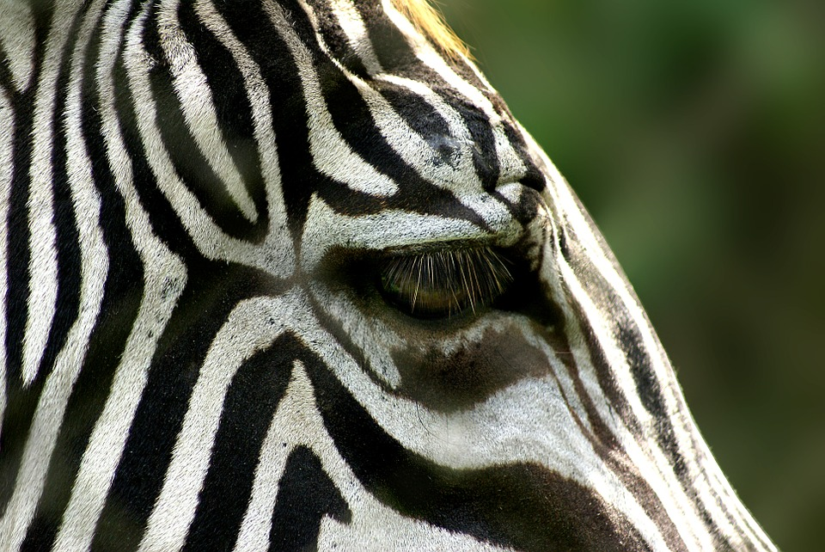
Approaches to Integrative Health for Persons with Ehlers-Danlos Syndrome
Kendra Neilsen Myles
Clair A. Francomano, MD

Slide 2
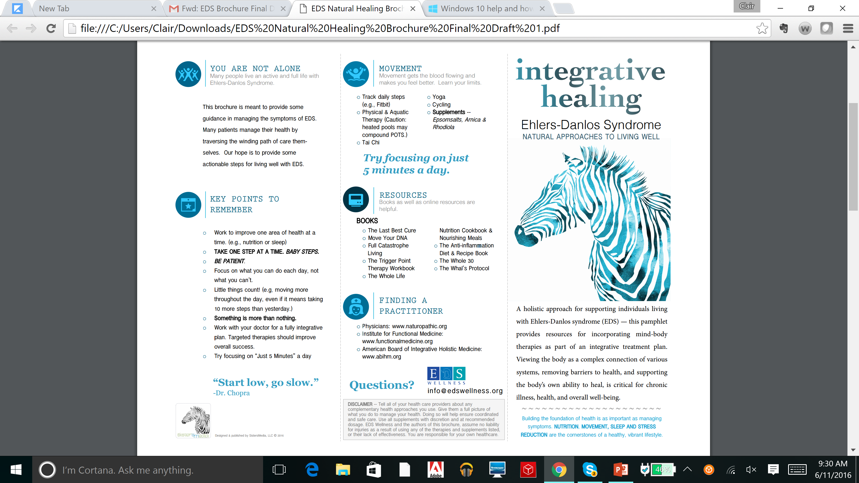

Slide 3
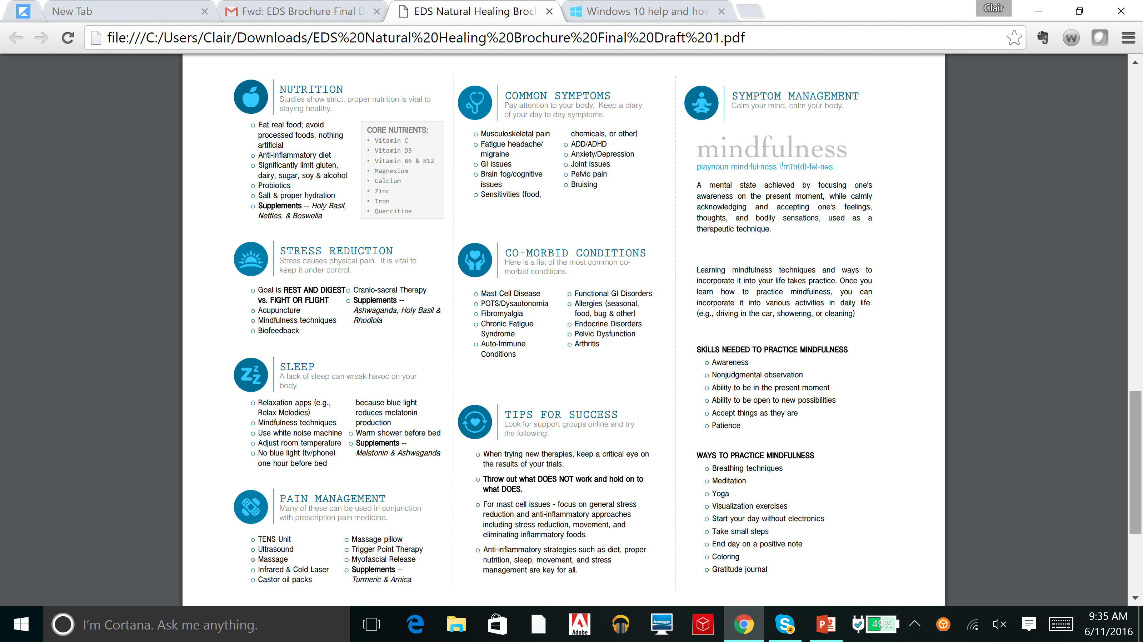

Slide 4
Common Symptoms
Musculoskeletal pain
Fatigue
Headache/ migraine
GI issues
Brain fog/cognitive issues
Sensitivities (food, chemicals, or other)
ADD/ADHD
Anxiety/Depression
Joint issues
Pelvic pain
Bruising

Slide 5
Co-Morbid Conditions
Mast Cell Disease
POTS/Dysautonomia
Fibromyalgia
Chronic Fatigue Syndrome
Auto-Immune Conditions
Functional GI Disorders
Allergies (seasonal, food, bug & other)
Endocrine Disorders
Pelvic Dysfunction
Arthritis

Slide 6
YOU ARE NOT ALONE Many people live an active and full life with Ehlers-Danlos Syndrome.
This brochure is meant to provide some guidance in managing the symptoms of EDS. Many patients manage their health by traversing the winding path of care themselves. Our hope is to provide some actionable steps for living well with EDS

Slide 7
KEY POINTS TO REMEMBER
Work to improve one area of health at a time. (e.g., nutrition or sleep)
TAKE ONE STEP AT A TIME. BABY STEPS !
BE PATIENT.
Focus on what you can do each day, not what you can’t
Little things count! (e.g, moving more throughout the day, even if it means taking 10 more steps than yesterday.)
Something is more than nothing!
Work with your doctor for a fully integrative plan
Targeted therapies should improve overall success
Try focusing on “Just 5 Minutes” a day

Slide 8
“Start low, go slow.” -Dr. Chopra

Slide 9
NUTRITION: Studies show proper nutrition is vital to staying healthy
Eat real food; avoid processed foods, nothing artificial
Anti-inflammatory diet (www.histaminintoleranz.ch)
Significantly limit gluten, dairy, sugar, soy & alcohol
Probiotics
Salt & proper hydration
Supplements -- Holy Basil, Nettles, Quercetin & Boswella

Slide 10
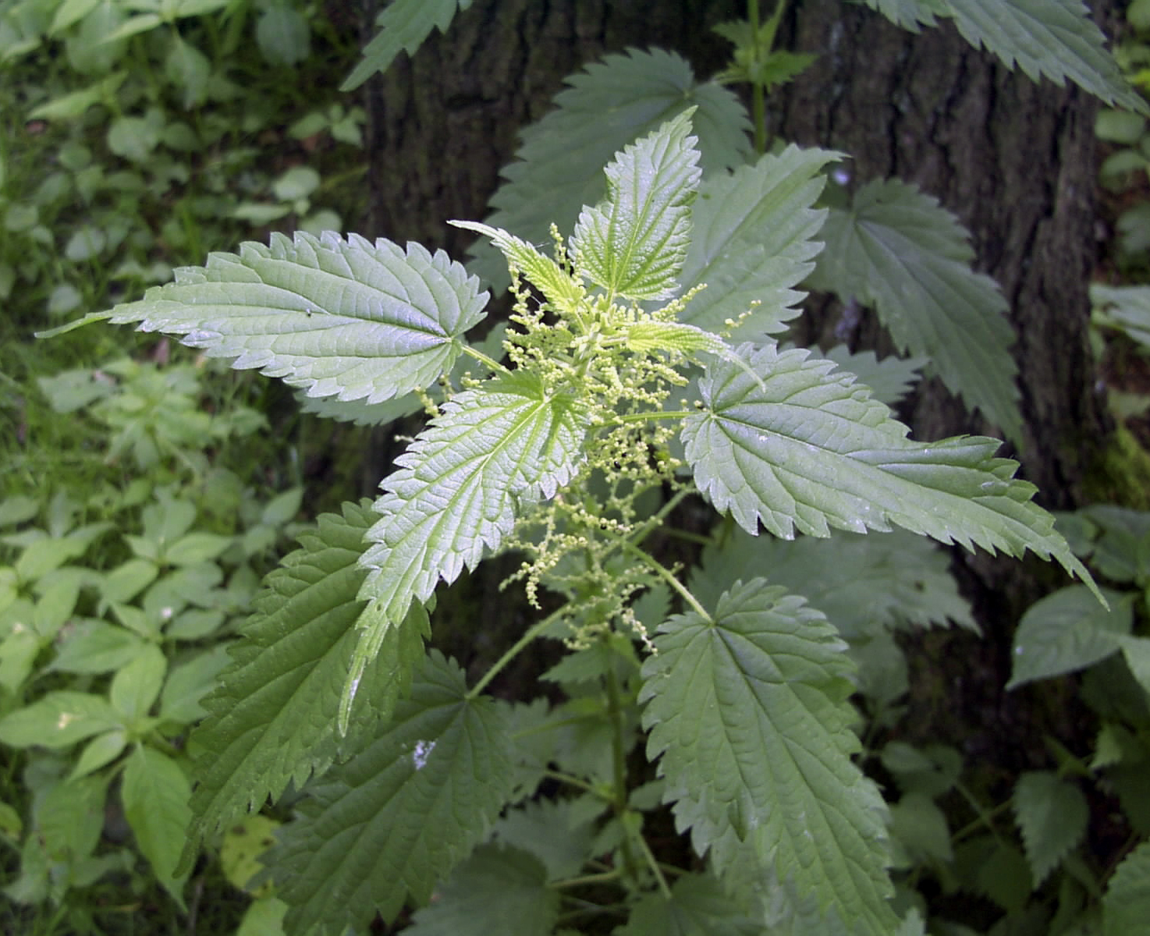
Stinging Nettle
Anti-inflammatory effect when ingested

Slide 11
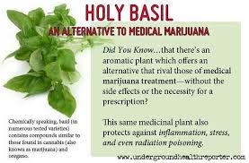

Slide 12
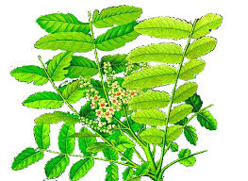
Boswellia serrata
An Ayurvedic herb also classified as a phytopharmaceutical (H15; Europe) which appears to be quite anti-inflammatory, helpful against osteoarthritis, and may help cerebral edema. Boswellia serrata appears to have preliminary evidence for anti-inflammatory joint disordersdisorders.

Slide 13
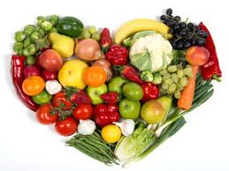
CORE NUTRIENTS
Vitamin C
Vitamin D3
Vitamin B6 & B12
Magnesium
Calcium
Zinc
Iron

Slide 14
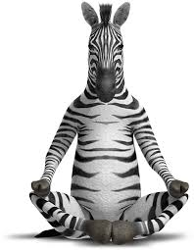
STRESS REDUCTION Stress causes physical pain. It is vital to keep it under control
Goal is REST AND DIGEST vs. FIGHT OR FLIGHT
Acupuncture
Mindfulness techniques
Biofeedback
Cranio-sacral Therapy
Supplements -- Ashwaganda, Holy Basil & Rhodiola

Slide 15
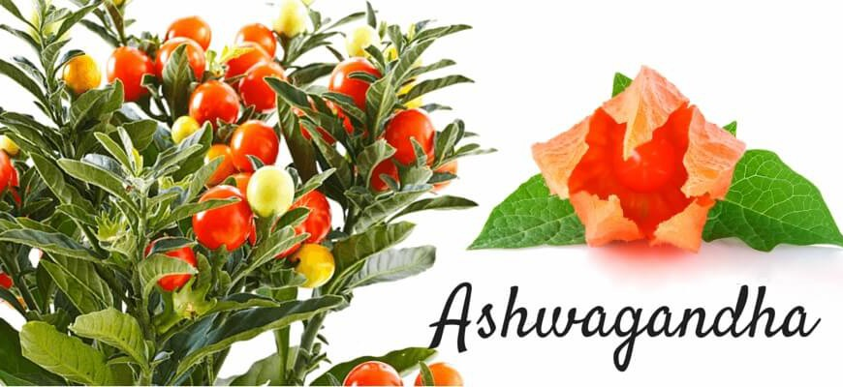

Slide 16
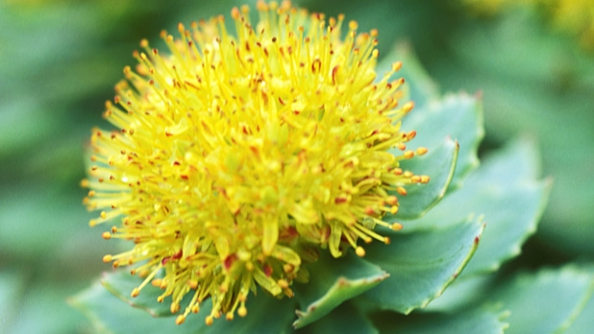
Rhodiola
Rhodiola rosea is a Traditional Chinese Medicine and Scandinavian herb touted to promote physical/cognitive vitality. It appears to be proven for reducing fatigue and exhaustion in prolonged stressful situations. Rhodiola is also neuroprotective and promotes longevity in preliminary evidence.

Slide 17
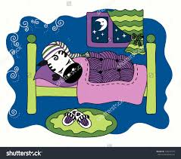
SLEEP A lack of sleep can wreak havoc on your body
Relaxation apps (e.g., Relax Melodies)
Mindfulness techniques
Use white noise machine
Adjust room temperature
No blue light (tv/phone) one hour before (blue light reduces melatonin production)
Warm shower before bed
Supplements -- Melatonin & Ashwaganda

Slide 18
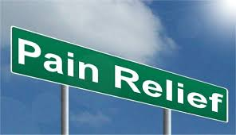
Pain Management
TENS Unit
Ultrasound
Massage
Infrared & Cold Laser
Castor oil packs
Massage pillow
Trigger Point Therapy
Myofascial Release
Supplements – Turmeric, Arnica

Slide 19
Tumeric
A potent anti-inflammatory super-food
Inhibits NF-kappa B, the master inflammatory cytokine

Slide 20
Arnica
Tincture of arnica is an external remedy for bruises, sprains, and sore muscles and joints. It is made by crushing whole plants and soaking them in alcohol.
Arnica is toxic if it gets inside the body. Never apply arnica in any form on broken skin or on an open wound.

Slide 21
Movement
Track daily steps (e.g., Fitbit)
Physical & Aquatic Therapy (Caution: heated pools may compound POTS.)
Tai Chi
Yoga
Cycling
Supplements – Epsom salts, Arnica & Rhodiola

Slide 22
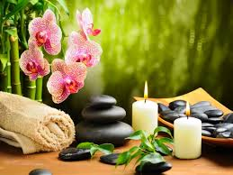
Mindfulness
A mental state achieved by focusing one's awareness on the present moment, while calmly acknowledging and accepting one's feelings, thoughts, and bodily sensations, used as a therapeutic technique
A mental state achieved by focusing one's awareness on the present moment, while calmly acknowledging and accepting one's feelings, thoughts, and bodily sensations, used as a therapeutic technique
Mindfulness

Slide 23
Books
The Last Best Cure – Donna Nakazawa
Move Your DNA - Katy Bowman
Full Catastrophe Living – Jon Kabat-Zinn
The Trigger Point Therapy Workbook – Claire Davies
The Whole Life Nutrition Cookbook & Nourishing Meals
The Anti-inflammation Diet & Recipe Book
The Whole 30
The Whals Protocol – Terry Whals

Slide 24
TIPS FOR SUCCESS Look for support groups online and try the following
When trying new therapies, keep a critical eye on the results of your trials
Throw out what DOES NOT work and hold on to what DOES!
For mast cell issues - focus on general stress reduction and anti-inflammatory approaches including stress reduction, movement, and eliminating inflammatory foods
Anti-inflammatory strategies such as diet, proper nutrition, sleep, movement, and stress management are key for all

Slide 25
